Slide 1
Median
Munene Gatobu

Slide 2






Initial Problem
Too many media platforms
Difficult to track shows, movies, books, or any media all in one place
Each platform tends to have it’s own media tracking service (Not all in one place) and susceptible to change with shared accounts

Slide 3
Solution
The all in one media tracker Median
We promised to deliver an application that allows for:
Easy series tracking
Sorting
External links/information support
Additional series notes
And rating/preference system

Slide 4
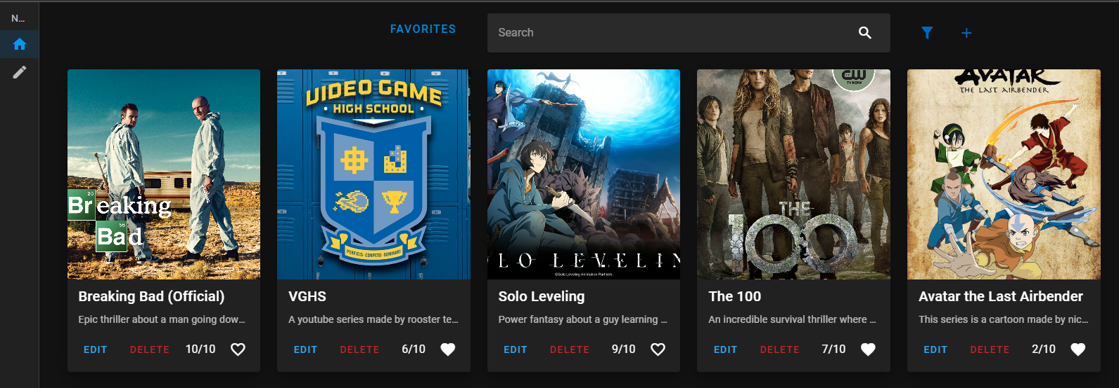
Demonstration screenshots

Slide 5
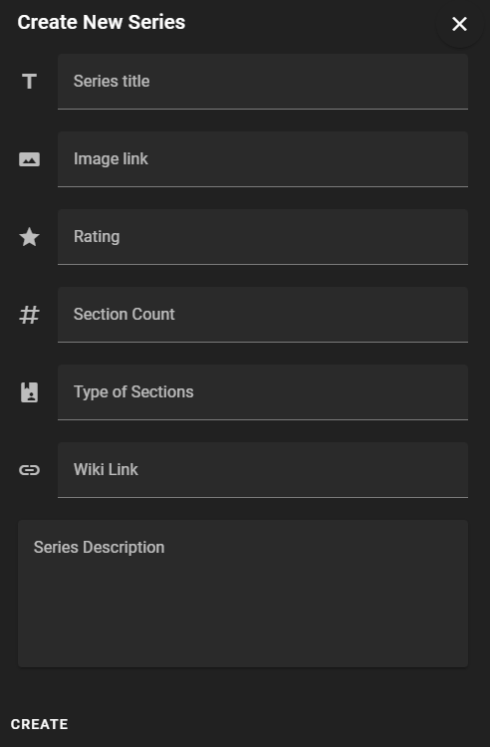
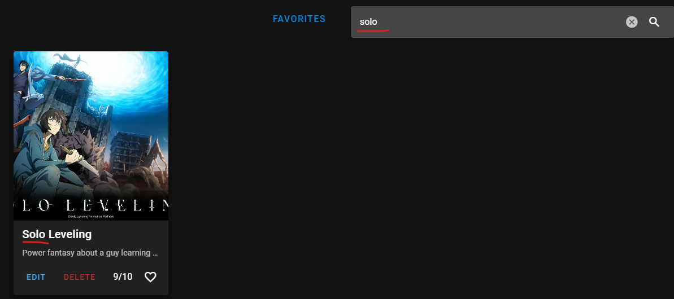
Demonstration screenshots

Slide 6
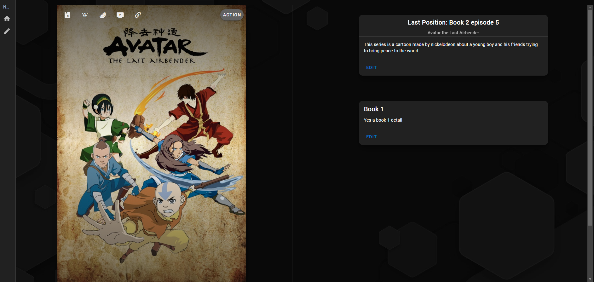
Demonstration screenshots

Slide 7
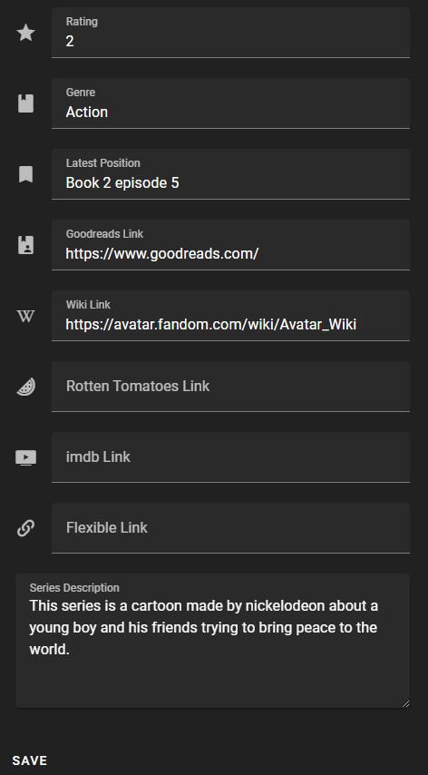
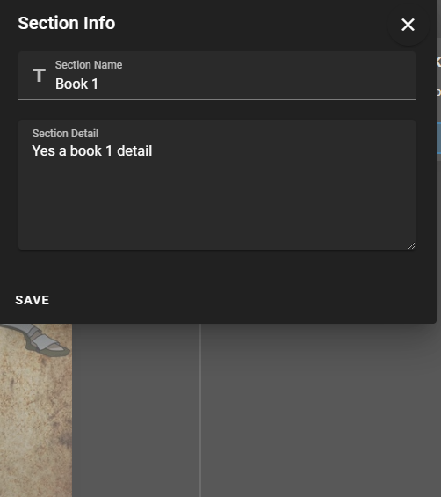

Demonstration screenshots

Slide 8




Built Using:
Overall Progress
About 1500 LoC
All features complete
Burndown Rate 100%
Requirements: 20/20 completed, 100% Burndown
Tests: 12/12 completed, 100% Coverage

Slide 9
Potential Improvements
Potential support for cross-platform
More responsive web design (Ties with point 1)
Visual indicators of small UI functions (Like searching)
More advanced sort/filter options

Slide 10
What I’ve learned
What I wish I knew
Try and discover potential edge cases with the tech stack being used
Make sure the database design can support extended features that may have been ignored
Front-end & back-end should be built in tandem not one before the other
Stick with tried and true tools/architecture designs
There is always something to improve
Dependency versions are crucial to sort out before any development begins
Front-end design goes much faster with a pre-made design

Slide 11
Thank you!
Q&A

